Slide 1


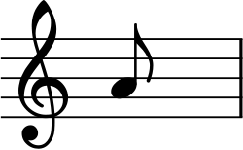
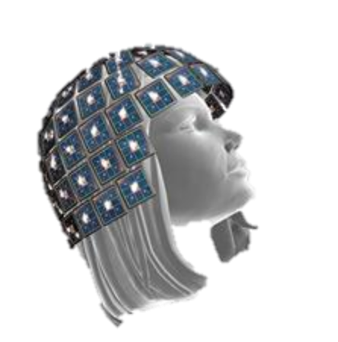
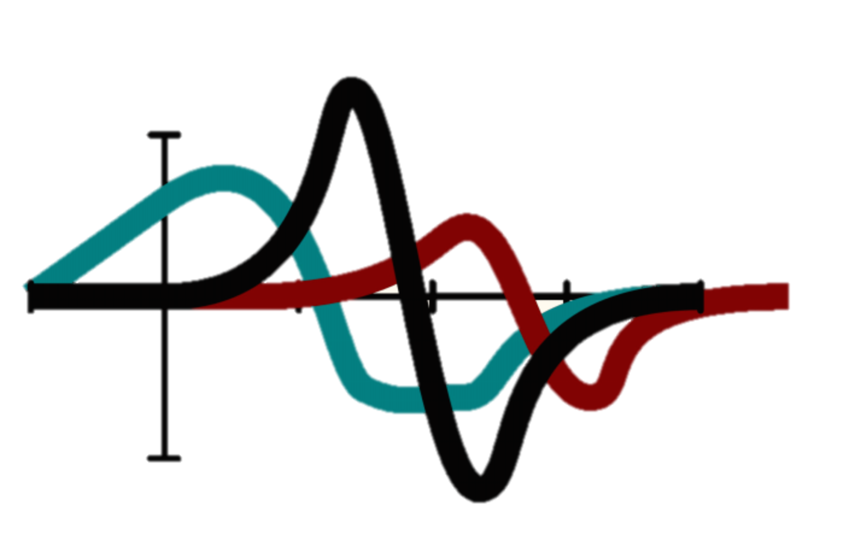



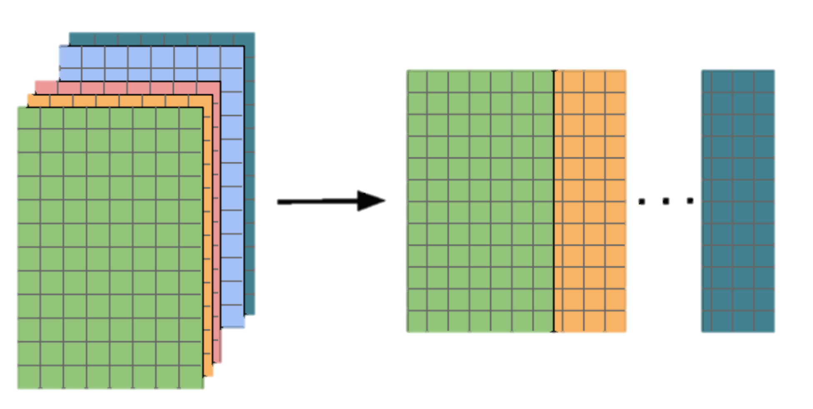
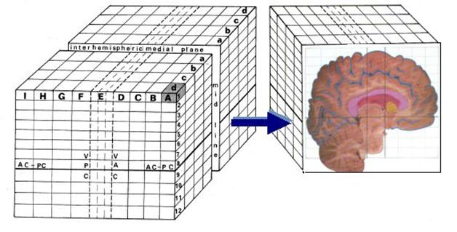
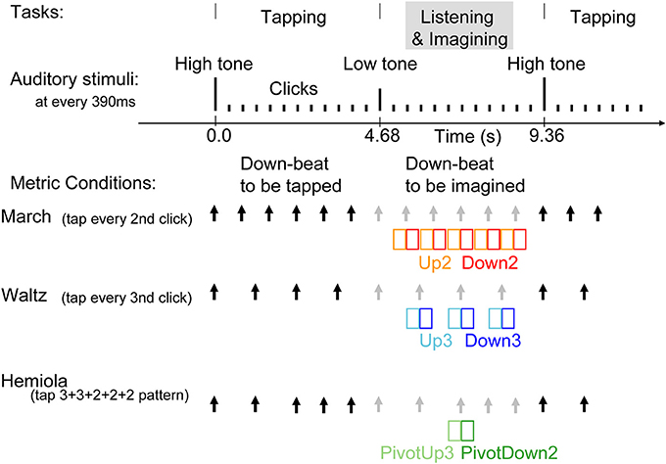
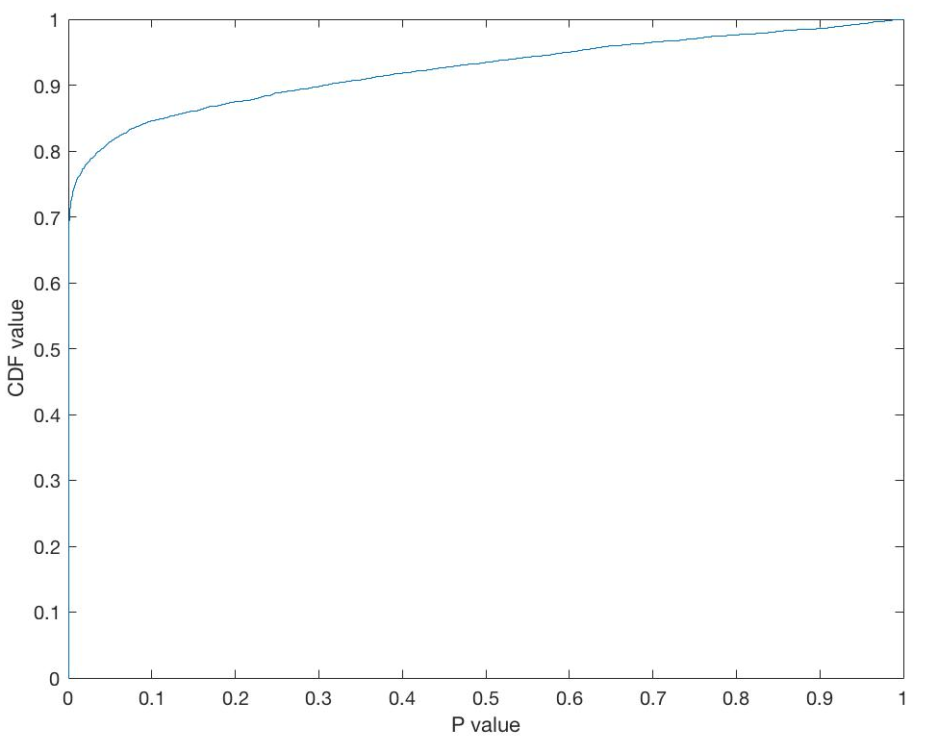
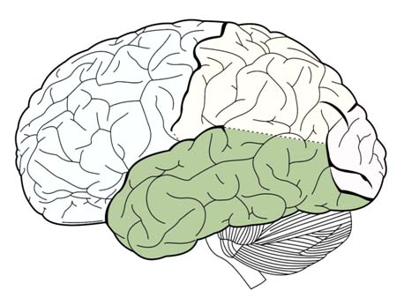
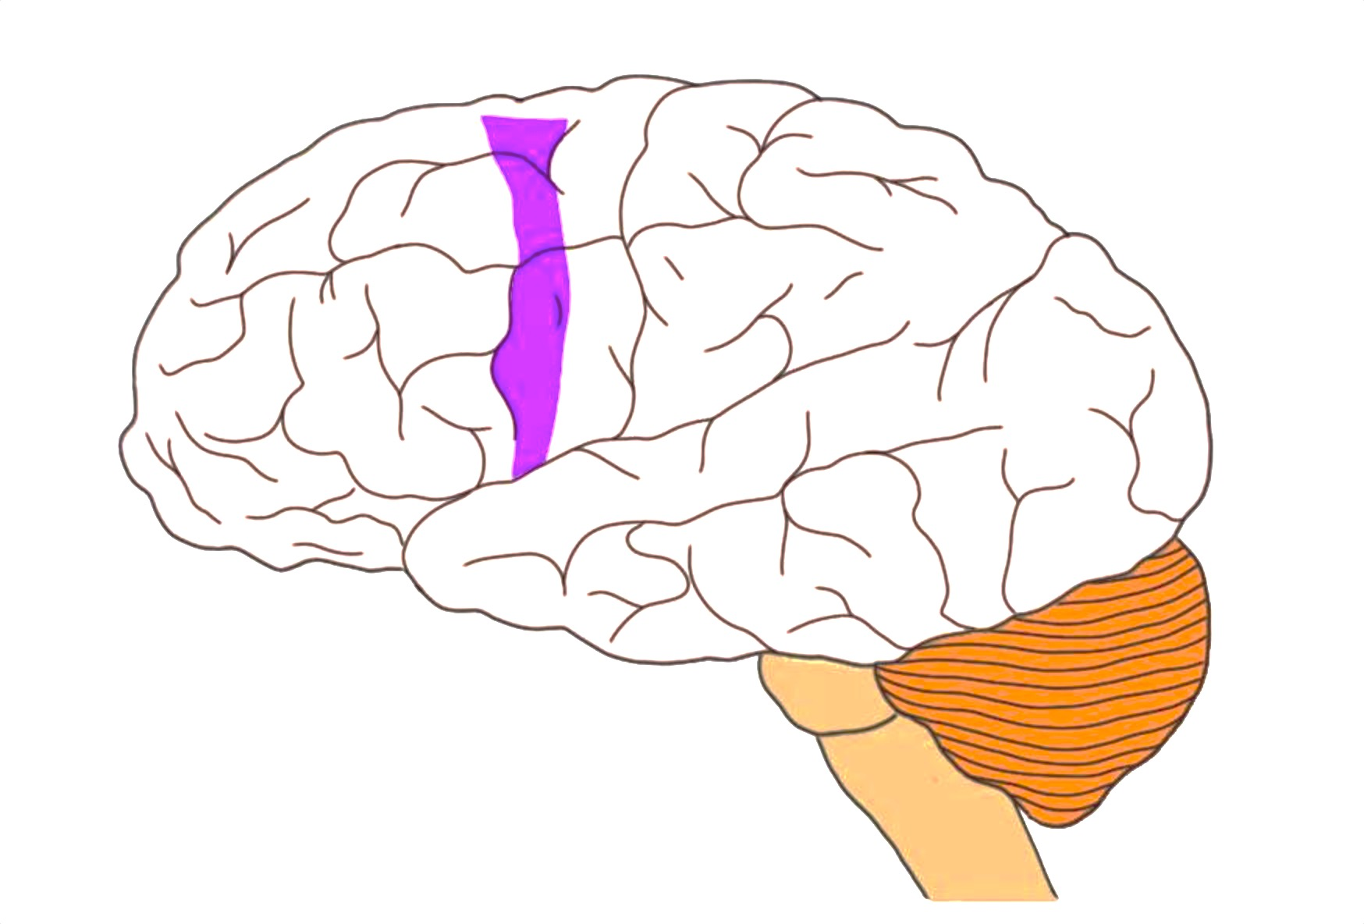
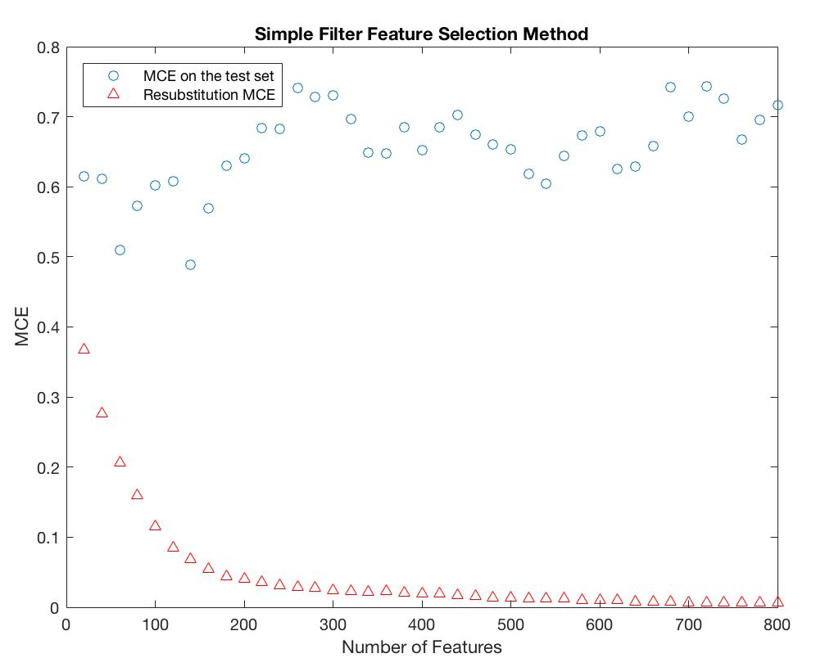
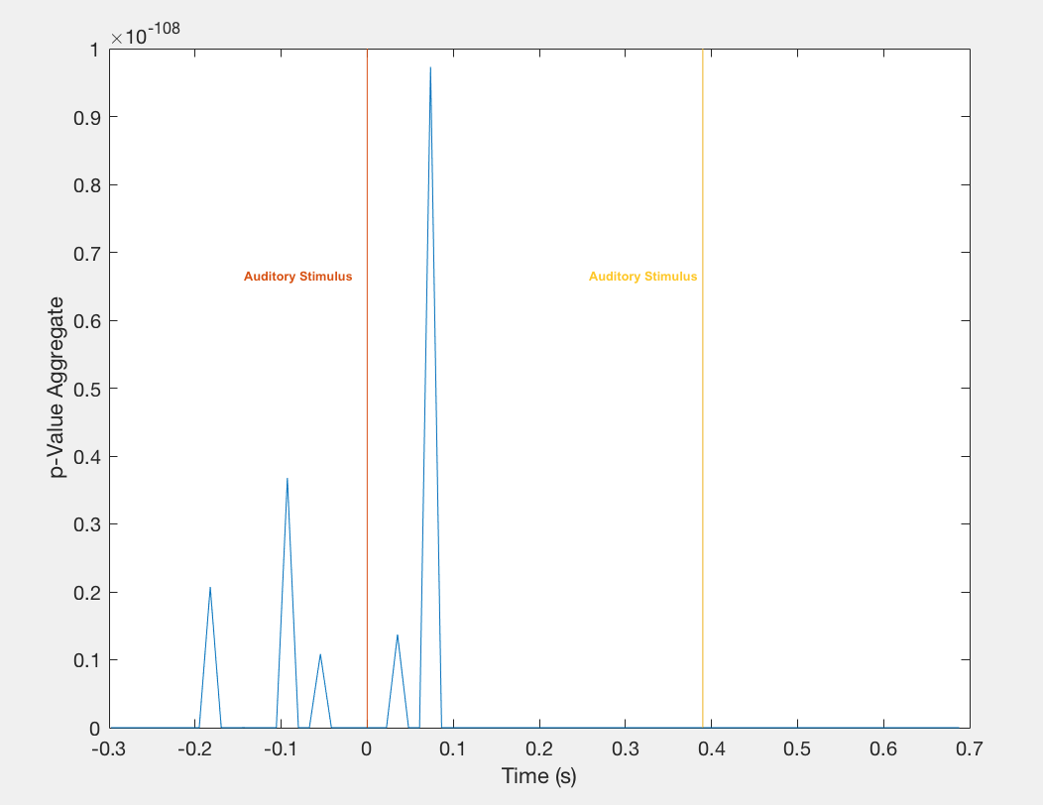
Predicting Imagined Meters in Musical Patterns from MEG Data
Ben Limonchik, Zoe-Alanah Robert, Aashna Shroff Computer Science, Stanford University
Motivation
Methodology
Results
Musical data is often interpreted within a metrical framework that integrates hierarchical timing information. Listening to metronomes and imagining different meters evoke auditory responses in temporal lobe and motor-related brain areas. We aim to use MEG data of imagined meters to classify the metrical framework (i.e. march, waltz or hemiola) that a person is imagining while listening to a constant metronome.
Both binary classification between ‘D2_T2’ and ‘PD2_H32’ and multiclass classification between ‘D2_T2’, ‘D3_T3’ and ‘PD2_H32’ was performed. Model was trained using trials of 10 people, and tested in two ways:
Using ‘seen people’, which the model was trained on
Using ‘unseen people’, which model was not trained on
Different models were tried, including Logistic Regression, Linear Discriminant, Quadratic Discriminant and different SVMs. Overall, Cubic SVM performed better.
Metronome beat
MEG data
Spatial- Temporal Brain Data
Machine Learning
Predicted imagination
Feature Engineering
Given the large number of observations and features, it was necessary to perform feature reduction to save storage and computation time and increase comprehensibility.
Data and Experiment
12 musicians studied. A constant metronome of 12 unaccented clicks was played with an interval of 390 ms. Participants were asked to imagine one of the following musical rhythms:
Any voxel outside the brain periphery with a zero-reading was removed, resulting in 4,840 remaining cubes.
The first and last 8 MEG measurements in the time-frame were removed so only 78 time-intervals remained.
Brain voxels were spatially averaged according to the Talairach coordinate system. Each voxel was mapped to one of 72 well-known regions of the brain.
Features were then selected using a filter approach. Applying the ttest on each feature and comparing the p-values, it is seen that 75% of the 5616 (72 avg. cortextes x 78 time intervals) had strong discriminative power. However, as seen in Figure 5, over-fitting occurs when more than 50 features are used. Best 50 features were selected according to their p-values.
Test Accuracy for | Seen | Unseen
100 random features out of 377,520 (78 time intervals x 4848 non-zero brain voxels) | 99.5% | 33.33%
5616 features (78 time intervals x 72 averaged brain cortexes) | 98.2% | 38.50%
50 best features using filter approach |  | 43.23%
March: 1 2 1 2 1 2 1 2 1 2 1 2 Waltz: 1 2 3 1 2 3 1 2 3 1 2 3 Hemiola: 1 2 3 1 2 3 1 2 1 2 1 2
No. of participants | 12
No. of trials/ participant | 190
No. of time intervals | 94
No. of brain voxels | 12,180
Labeled classes | 9
Figure 2: Flattening of 3D spatial-temporal tensor into 2D matrix. Each row contains brain signals across all time intervals.
Class Labels:
'PD2_H32’ 'D2_T2’ 'D3_T3'
'D2_H32’ 'U2_T2 'M3_T3'
'PU3_H32’ 'U3_T3
'U3_H32’
Figure 6: Multiclass classification using different feature subsets using Cubic SVM
Analysis and Future Work
Figure 3: Human brain with superimposed Talairach grid
The 50 best features were mapped back to their original spatial and temporal locations and analyzed:
Spatial Brain Locations: Temporal lobe and pre-motor cortex areas were common, which are known to be involved in primary auditory perception.
Temporal Locations: Most indicative time intervals were about 0.05 s before and after the auditory stimulus.
In the future, it would be interesting to leverage feature engineering to avoid overfitting and be able to make better predictions for unseen people across more metrical classifications.
Figure 7: Temporal Lobe; Pre-Motor Cortex
Figure 4: Empirical CDF of p-values
Figure 1: Stimulus sequence and tasks
Overall, the data consisted 190 trials * 12 participants * 9 classifications = 20,520 data points, each with 12,180 voxels * 94 time-intervals = 1,169,280 features.
Figure 5: Resubstitution and Test Misclassification error for different features
Figure 8: Time Interval vs. Aggregated p-values

